Slide 1
Binary Search
Binary search. Given value and sorted array a[], find index i
such that a[i] = value, or report that no such index exists.
Invariant. Algorithm maintains a[lo] ≤ value ≤ a[hi].
Ex. Binary search for 33.
6
13
14
25
33
43
51
53
64
72
84
93
95
96
97
0
1
2
3
4
5
6
7
8
9
10
11
12
13
14
lo
hi

Slide 2
Binary Search
Binary search. Given value and sorted array a[], find index i
such that a[i] = value, or report that no such index exists.
Invariant. Algorithm maintains a[lo] ≤ value ≤ a[hi].
Ex. Binary search for 33.
6
13
14
25
33
43
51
53
64
72
84
93
95
96
97
0
1
2
3
4
5
6
7
8
9
10
11
12
13
14
lo
mid
hi

Slide 3
Binary Search
Binary search. Given value and sorted array a[], find index i
such that a[i] = value, or report that no such index exists.
Invariant. Algorithm maintains a[lo] ≤ value ≤ a[hi].
Ex. Binary search for 33.
6
13
14
25
33
43
51
53
64
72
84
93
95
96
97
0
1
2
3
4
5
6
7
8
9
10
11
12
13
14
lo
hi

Slide 4
Binary Search
Binary search. Given value and sorted array a[], find index i
such that a[i] = value, or report that no such index exists.
Invariant. Algorithm maintains a[lo] ≤ value ≤ a[hi].
Ex. Binary search for 33.
6
13
14
25
33
43
51
53
64
72
84
93
95
96
97
0
1
2
3
4
5
6
7
8
9
10
11
12
13
14
lo
mid
hi

Slide 5
Binary Search
Binary search. Given value and sorted array a[], find index i
such that a[i] = value, or report that no such index exists.
Invariant. Algorithm maintains a[lo] ≤ value ≤ a[hi].
Ex. Binary search for 33.
6
13
14
25
33
43
51
53
64
72
84
93
95
96
97
0
1
2
3
4
5
6
7
8
9
10
11
12
13
14
lo
hi

Slide 6
Binary Search
Binary search. Given value and sorted array a[], find index i
such that a[i] = value, or report that no such index exists.
Invariant. Algorithm maintains a[lo] ≤ value ≤ a[hi].
Ex. Binary search for 33.
6
13
14
25
33
43
51
53
64
72
84
93
95
96
97
0
1
2
3
4
5
6
7
8
9
10
11
12
13
14
lo
mid
hi

Slide 7
Binary Search
Binary search. Given value and sorted array a[], find index i
such that a[i] = value, or report that no such index exists.
Invariant. Algorithm maintains a[lo] ≤ value ≤ a[hi].
Ex. Binary search for 33.
6
13
14
25
33
43
51
53
64
72
84
93
95
96
97
0
1
2
3
4
5
6
7
8
9
10
11
12
13
14
lo
hi

Slide 8
Binary Search
Binary search. Given value and sorted array a[], find index i
such that a[i] = value, or report that no such index exists.
Invariant. Algorithm maintains a[lo] ≤ value ≤ a[hi].
Ex. Binary search for 33.
6
13
14
25
33
43
51
53
64
72
84
93
95
96
97
0
1
2
3
4
5
6
7
8
9
10
11
12
13
14
lo
hi
mid

Slide 9
Binary Search
Binary search. Given value and sorted array a[], find index i
such that a[i] = value, or report that no such index exists.
Invariant. Algorithm maintains a[lo] ≤ value ≤ a[hi].
Ex. Binary search for 33.
6
13
14
25
33
43
51
53
64
72
84
93
95
96
97
0
1
2
3
4
5
6
7
8
9
10
11
12
13
14
lo
hi
mid

Slide 10
Search Algorithm : Binary Search
int search(int A[], int N, int Num) {
int first = 0;
int last = N - 1;
int mid = (first + last) / 2;
while ((A[mid] != Num) && (first <= last)) {
if (A[mid] > Num)
last = mid - 1;
if(A[mid]<Num)
first = mid + 1;
mid = (first + last) / 2;
}
if (A[mid] == Num)
return mid;
else
return -1;
}

Slide 11
Analyzing Binary Search
One comparison after loop
First time through loop, toss half of array (2 comps)
Second time, half remainder (1/4 original) 2 comps
Third time, half remainder (1/8 original) 2 comps
…
Loop Iteration Remaining Elements
1 N/2
2 N/4
3 N/8
4 N/16
…
?? 1
How long to get to 1?

Slide 12
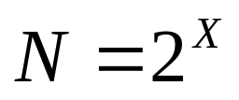
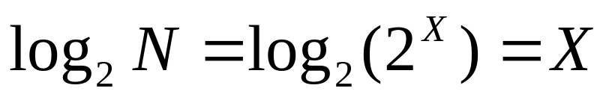
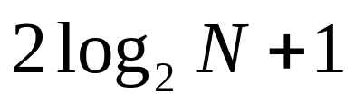
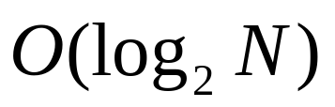
Analyzing Binary Search (cont)
Looking at the problem in reverse, how long to double the number 1 until we get to N?
and solve for X
two comparisons for each iteration, plus one comparison at the end -- binary search takes
in the worst case
Binary search is worst-case

